Slide 1
Section 1
Agile Testing Principles
Principles
Notes:
Copyright © 2017 nTier Training, LLC. All rights reserved.
1-<number>
20170313
TDD and BDD

Slide 2
Section Objectives
Role definition
Traditional after the fact testing versus in just in time testing
The Testing Pyramid
20170313
Copyright © 2017 nTier Training, LLC. All rights reserved.
1-<number>
Notes:
Copyright © 2017 nTier Training, LLC. All rights reserved.
1-<number>
20170313
TDD and BDD

Slide 3
Agile Testing Principles
Principles
Principles
Notes:
Copyright © 2017 nTier Training, LLC. All rights reserved.
1-<number>
20170313
TDD and BDD

Slide 4
Tradition
Traditional “code then test” approach
  Separate, siloed teams
  Heavyweight process
  Requirements, design documents
  Test plans
  “Traceability”
  Change review boards
  Testing “bottleneck” at end
Automation
  Done by testers or automation team
  If developers automate unit tests, it is after they have coded a solution
20170313
Copyright © 2017 nTier Training, LLC. All rights reserved.
1-<number>
Notes:
Copyright © 2017 nTier Training, LLC. All rights reserved.
1-<number>
20170313
TDD and BDD

Slide 5
Becoming Agile
Exploring reveals unintended consequences and uncovers implicit expectations
Critical thinking; no requirements doc needed
Whole team approach
Coding and testing are one process
  Feedback and collaboration are key
  Test driven development (TDD)
  Behavior Driven Development (BDD)
20170313
Copyright © 2017 nTier Training, LLC. All rights reserved.
1-<number>
Notes:
Copyright © 2017 nTier Training, LLC. All rights reserved.
1-<number>
20170313
TDD and BDD

Slide 6
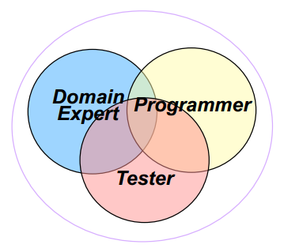
Break the Roles
The Agile team approach means we move from a silo role-defined team to a team where members have overlapping responsibilities
Business Analyst
Developer
Tester
20170313
Copyright © 2017 nTier Training, LLC. All rights reserved.
1-<number>
Notes:
Team responsible for testing
Testers get support, training
Developers do testing activities
Testers and developers pair
Copyright © 2017 nTier Training, LLC. All rights reserved.
1-<number>
20170313
TDD and BDD

Slide 7
Testing is NOT a Phase
Development = Testing + Coding
Write test, write code, test
  At Unit and Acceptance test levels
Automated tests
  Designed for efficiency, maintainability
Free time for exploratory testing
Team plans testing activities
Team uses feedback to improve
  Testers are expert feedback providers
  Feedback lets team make corrections
    Continuous integration of test results
    Retrospectives
    Short iterations facilitate improvement
    Collaboration with users, customers
20170313
Copyright © 2017 nTier Training, LLC. All rights reserved.
1-<number>
Notes:
Copyright © 2017 nTier Training, LLC. All rights reserved.
1-<number>
20170313
TDD and BDD

Slide 8
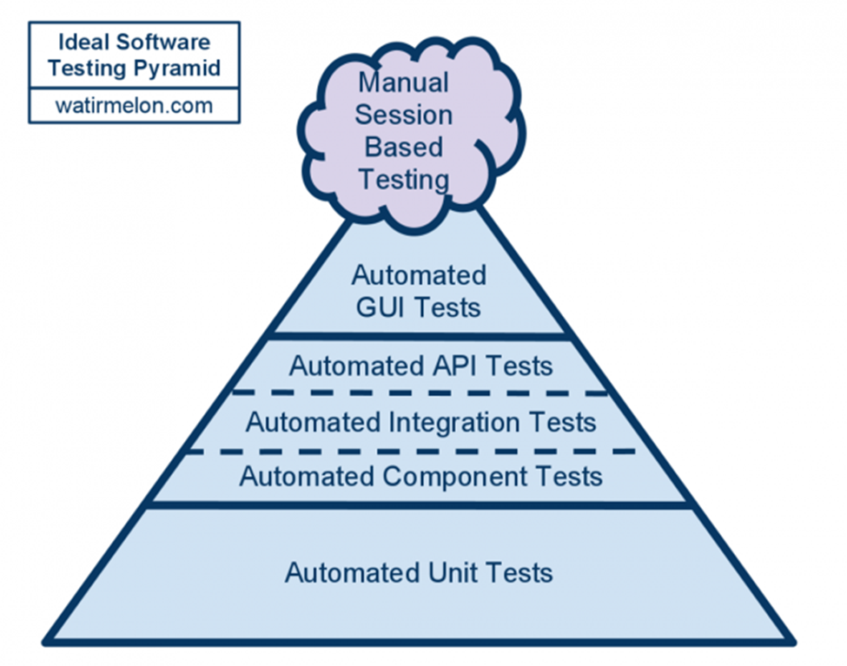
Direction – The Testing Pyramid
Lines between roles blurred
More focus on tests to drive coding
Maximize automation
Reduce end-to-end visual inspection
Increase unit testing
Mock collaborations
Find ways to control technical debt
20170313
Copyright © 2017 nTier Training, LLC. All rights reserved.
2-<number>
Notes:
The Agile Testing Pyramid is a handy way of describing the difference between traditional software testing and testing for iterative development. The differences are important for Agile success and require re-thinking and re-tooling for many organizations
The concept of The Agile Testing Pyramid has been described by many people and, I am pretty sure, originated by Mike Cohn
Agile testing relies more on automation. It requires a much greater contribution from developers, and it has a different basic philosophy – To prevent bugs
Developers must validate their own work with unit tests. The typical tools for this are xUnit implementations for the language in use
Copyright © 2017 nTier Training, LLC. All rights reserved.
2-<number>
20170313
Agile Testing

Slide 9
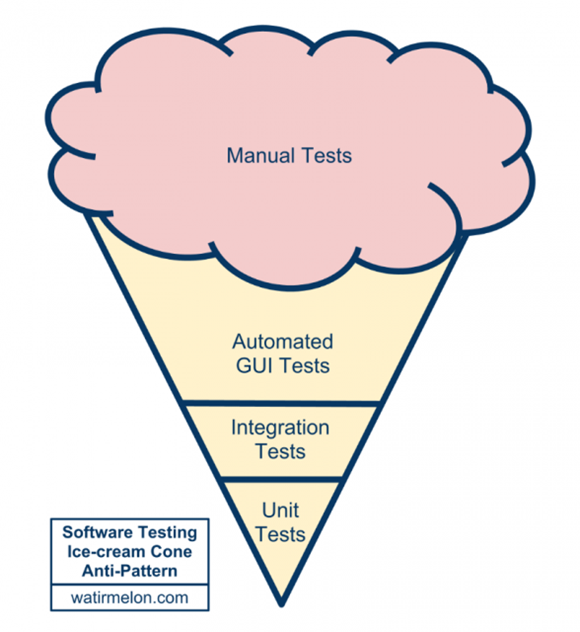
Ice cream anyone?
Tests that execute a whole component, for example a web service, are quite high-level too, compared to a unit test. The ice cream cone anti-pattern is a nice illustration of TDD gone wrong.
An ice cream cone emerges when you invert the ideal test automation pyramid.
You can make ice cream by creating more integration tests than unit tests and more GUI tests than integration tests and even more manual regression tests than your automated GUI tests.
20170313
Copyright © 2017 nTier Training, LLC. All rights reserved.
2-<number>
Notes:
https://zeroturnaround.com/rebellabs/if-and-when-you-should-use-test-driven-development/
Copyright © 2017 nTier Training, LLC. All rights reserved.
2-<number>
20170313
Agile Testing

Slide 10
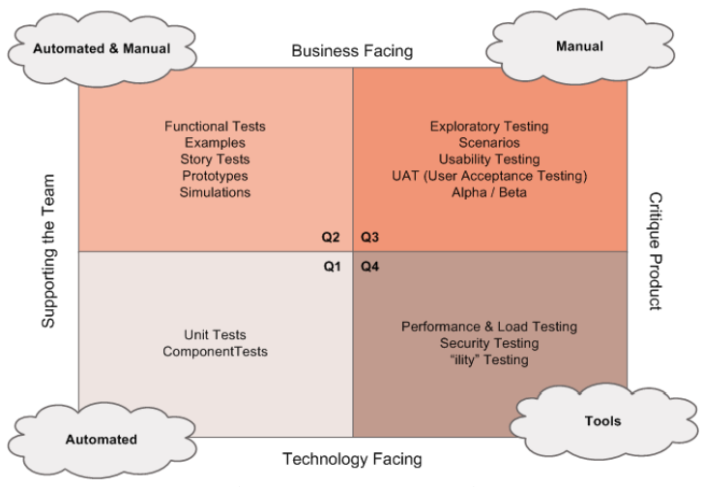
Agile Testing Quadrants
20170313
Copyright © 2017 nTier Training, LLC. All rights reserved.
1-<number>
Notes:
The quadrant numbering system does NOT imply any order. You don’t work through the quadrants from 1 to 4 in a waterfall style
Most projects would start with Q2 tests, because those are where you get the examples that turn into specifications and tests that drive coding, along with prototypes and the like
Q3 and Q4 testing pretty much require that some code be written and deployable, but most teams iterate through the quadrants rapidly, working in small increments
Write a test for some small chunk of a feature, then write the code. Once the test is passing, perhaps you will automate more tests for it, do exploratory testing on it, do security or load testing on it – whatever – then add the next small chunk and go through the whole process again
The quadrants are merely a taxonomy to help teams plan their testing and make sure they have all the resources they need to accomplish it
Copyright © 2017 nTier Training, LLC. All rights reserved.
1-<number>
20170313
TDD and BDD

